Slide 1
QuickSight Architecture

Slide 2
Use Cases
1a. Savana Call History
1b. Source – Savana Report “Open Cases By Assignee” pulled from Savana Dev on Dec-22-2022
1c. QuickSight Dataset – Athena
1d. Requirement – Provided by Chello
2a. Loan Conversion
2b. Source – FINXACT & Party Registration. Last refreshed in Dev on Jan-06-2023
2c. QuickSight Dataset – Athena
2d. Requirement – Created for Demo purpose
3a. Sales and Marketing
3b. Source – TriZetto (Campaign), Pardot, Google Analytics, DynamoDB (LOAN_CONV_DTL, INT_ACC_DTL, PTY_RGST_LOG). Last refreshed in Dev on Jan-06-2023
3c. QuickSight Dataset – Athena
3d. Requirement – Created for Demo purpose

Slide 3
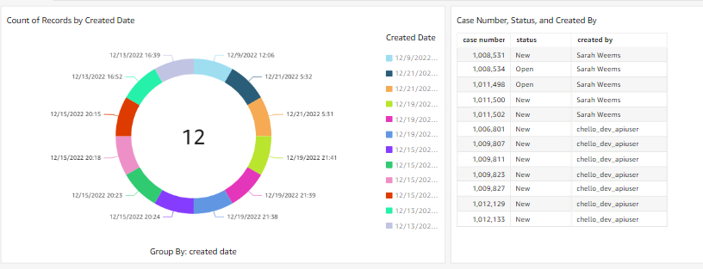
Savana - Open Cases by Assignee
Filtering by the date when the case is created.
Visualizing Case Number, Status of the case and Assignee on that date.

Slide 4
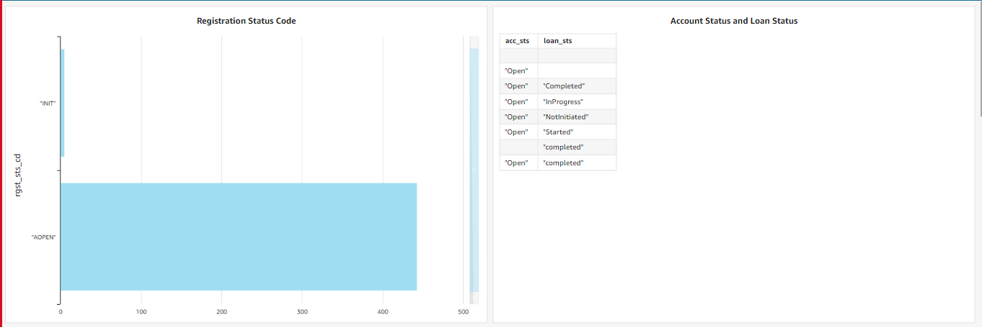
Loan Conversion
Filtering by Registration Status Code
Based upon Registration Status Code we are Visualizing Account Status and Loan Status
Based upon Loan status which are completed we are visualizing Application Start Time Stamp and Current Credit Limit
Taking Average of Current Credit Limit and Loan Credit Limit.

Slide 5
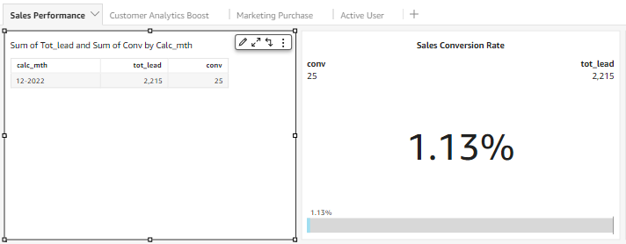
Sales and Marketing
Sales Performance
Sales Conversion Rate:
1.1. Total number of Sales / Qualified Sales * 100

Slide 6
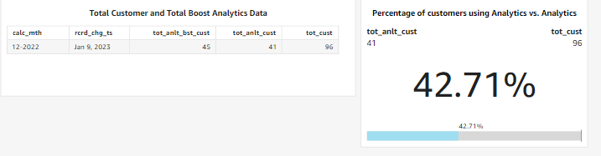
Sales and Marketing
Sales Performance
Percentage of customers using Analytics vs. Analytics and Boost
1.2. Total number of Customers Analytics Only / Total number of Customers

Slide 7
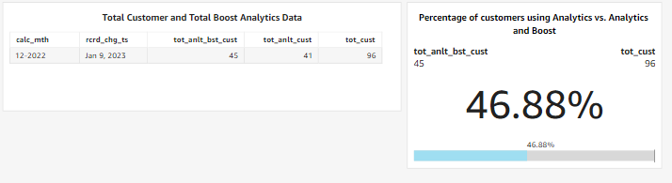
Sales and Marketing
Sales Performance
Percentage of customers using Analytics vs. Analytics and Boost 1.3. Total number of Customers Analytics + Boost / Total number of Customers

Slide 8
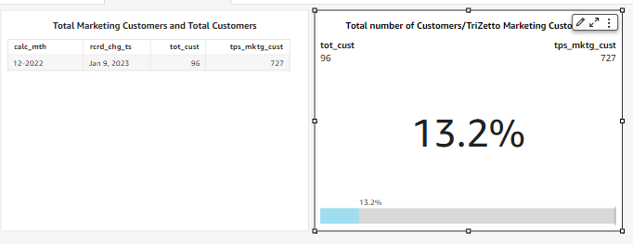
Sales and Marketing
2. Marketing Performance
Number of users brought through TriZetto Marketing vs clicking on their own:
2.1. TriZetto Marketing Customers / Total number of Customers

Slide 9
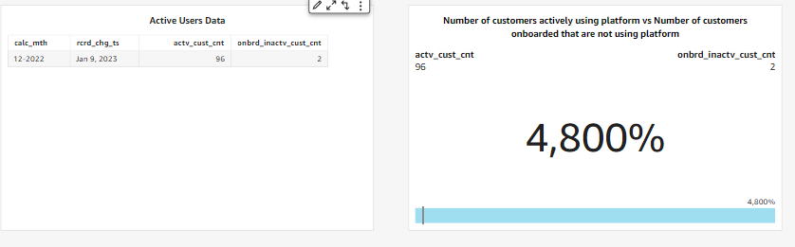
Sales and Marketing
2. Marketing Performance
Number of Active Users:
2.2. Number of customers actively using platform vs Number of customers onboarded that are not using platform

